Slide 1
ASSIGNMENT 1- sample business requirement document template
Name- KARTIKI BORAWAKE
PRN NUMBER-2124UCEF1045

Slide 2
Q.DEFINE A PROBLEM STATEMENT AND GIVE A BREIF EXECUTIVE SUMMARY SNAPSHOT
1-PROBLEM
As we all know nowadays kids from age group 5-10 years are mostly engaged in activities which doesn’t have any physical activity involved which causes a negative impact on their health and increases obesity. India has 2nd highest number of obese children in the world. The prevalence of overweight and obesity in children is 15% in India which causes number of diseases in children at very small age. The main reason behind it is overeating or unhealthy diet, reduced physical activities. So there’s a need of interactive platform that not only motivates kids but also adapts to their evolving fitness levels, offering progressively advanced physical activities in attractive way!!
2-EXECUTIVE SUMMARY SNAPSHOT

Slide 3
This proposal outlines the development of mobile application designed to revolutionize personal fitness through a gamified, level based system. The app will be game based to attract kids towards it. The app will start users on basic physical activities and progressively introduce more advanced exercises as they demonstrate improvement . Key features include personalized workout plans, progress tracking and community engagement, all aimed at enhancing sustained commitment to physical health.
3-PROJECT DESCRIPTION-
The project entails creating a user centric fitness app that operates on a tiered level system. The app will be a game including levels in it and till the last level the user will attain a good physical health . The app will have a Bluetooth system which connect to the smart watch and for an instance if it is level one and there’s a target to complete 3000 steps in a day for a kid and if he accomplishes the same then it will be tracked by the watch then second level will be unlocked and ahead it will be continued with different activities. The app’s core components include:
1-*Progress monitoring:*Tools and dashboards to track achievements and milestone.

Slide 4
-*Community features:*Options to connect with other users , share progresses and participate in group challenges to win exciting rewards!!
4-*Diet charts and plans:*A proper diet chart will be provided for children separate for both vegetarians and non vegetarians to maintain balance of nutrition in body
5-*Personalised fitness plans:*Customised fitness workout according to the users assesments.
4-Project Scope-
*PHASE 1:Reasearch & Planning*
-conduct market analysis and user surveys to identify more need of the users
-Define app features, design interfaces and establish technical requirements

Slide 5
*PHASE 2:Developement*
-Develop the app’s frontend and backend infrastructure’s.
-Integrate databases for exercises, users data and progress tracking.
*PHASE 3 :Testing*
-Perform beta testing with a selected user group to gather feedback.
-Refine features and fix bugs based on test results.
*Phase 4:Deployment*
-Launch the app on major platforms(IOS and Android).
-Implement marketing stratergies to attract and retain users.
A VISUAL OF THE APP IS SHOWN IN BELOW SLIDES

Slide 6
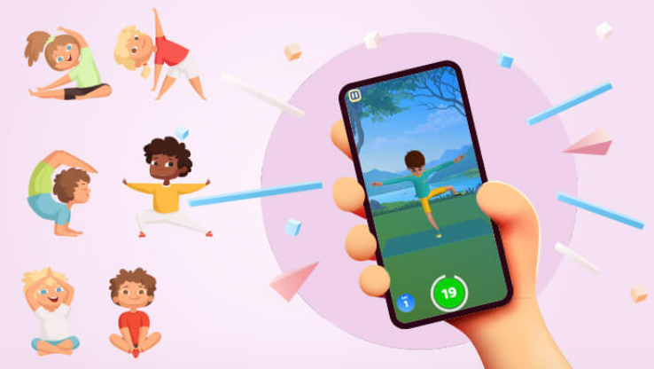
KIDDOFIT

Slide 7

WELCOME TO KIDDOFIT!!
Username-
Password
SIGN IN!!
LOG IN !!
HOME PAGE
FORGOT PASSWORD….!!

Slide 8


You are kid
OR
You are parent
NAME-
AGE-
WEIGHT-
HEIGHT-
DISEASE IF HAVING ANY-
ALLERGIES

Slide 9
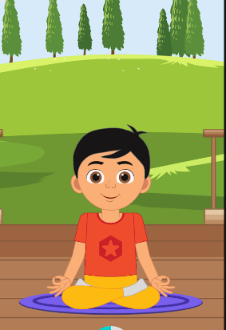
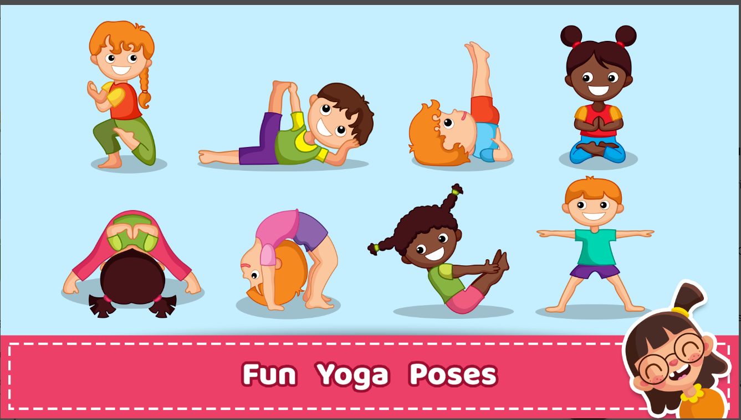
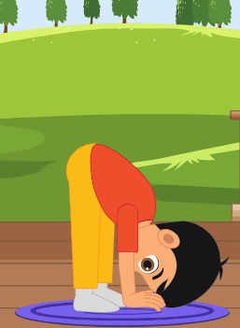
LEVEL-1
YOGA FOR KIDS

Slide 10
LEVEL- 2
3000 STEPS A DAY

Slide 11



Health Tips!!

Slide 12

THANK YOUU!!
RATINGS-

